Slide 1

Lending Club Loan Data Credit Risk Project
Denver G. Magtibay
AI in Automation and Finance
Prof. Aditya Narvekar

Slide 2

The Dataset
The data is called “Lending Club Loan Data”.
Lending Club is a peer-to-peer Lending company based in the US. They match people looking to invest money with people looking to borrow money. When investors invest their money through Lending Club, this money is passed onto borrowers, and when borrowers pay their loans back, the capital plus the interest passes on back to the investors. It is a win for everybody as they can get typically lower loan rates and higher investor returns.

Slide 3

Data Preparation

Slide 4
Data Preparation
I. Import Libraries
II. Import Data
III. Initial Data Exploration

Slide 5
Data Preparation
IV. Pre-processing
1. emp_length --> emp_length_int
2. earliest_cr_line --> mths_since_earliest_cr_line
3. term --> term_int
4. issue_d --> mths_since_issue_d

Slide 6
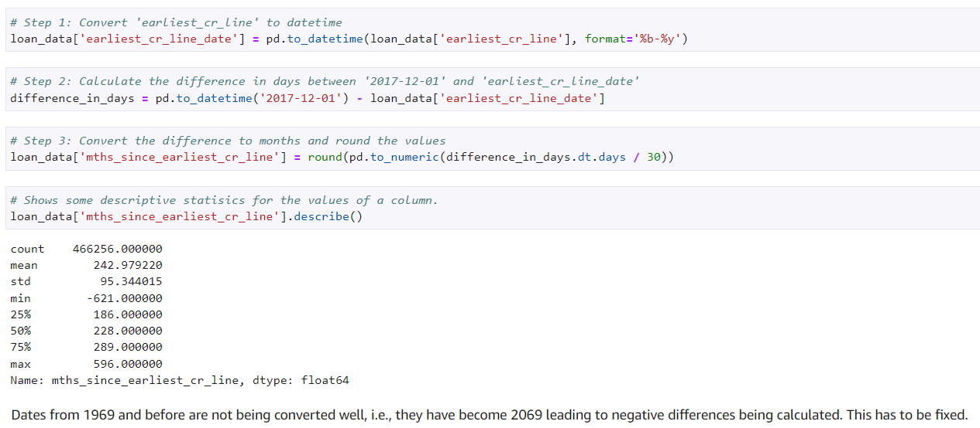
Problem: earliest_cr_line --> mths_since_earliest_cr_line

Slide 7
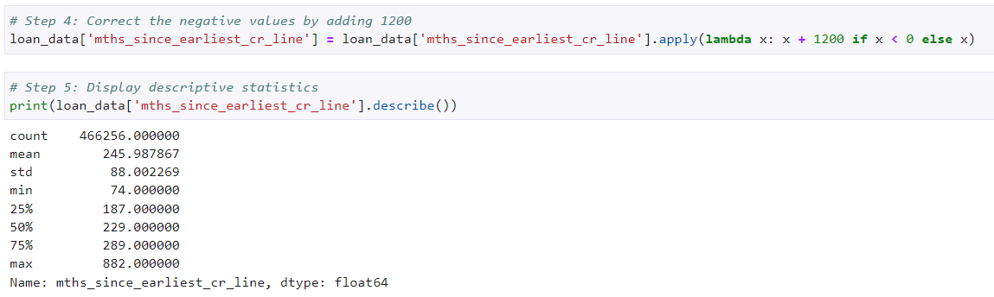
Improvement : earliest_cr_line --> mths_since_earliest_cr_line

Slide 8
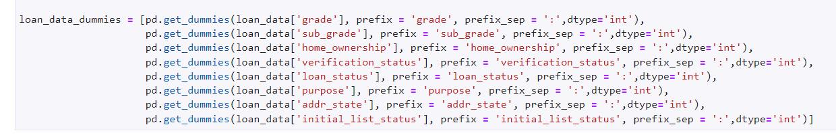
Data Preparation V. Processing discrete features
grade
sub_grade
home_ownership
verification_status
loan_status
purpose
addr_state
initial_list_status.

Slide 9
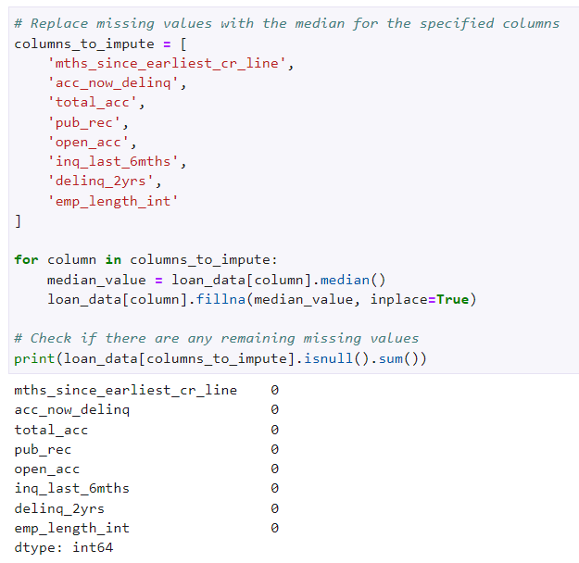
Data Preparation VI. Processing missing values
1. total_rev_hi_lim (Get the missing values from 'funded_amnt')
2. annual_inc (mean imputation)
3. Other columns (median imputation)
'mths_since_earliest_cr_line',
'acc_now_delinq',
'total_acc',
'pub_rec',
'open_acc',
'inq_last_6mths',
'delinq_2yrs',
'emp_length_int'

Slide 10
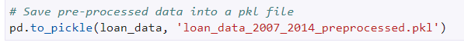
Data Preparation
Save the data for LGD and EAD

Slide 11
PD Model

Slide 12
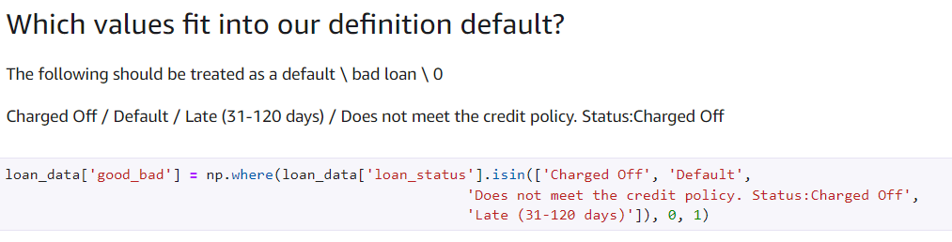
Creating the dependent variable (loan_status)

Slide 13
Computing weight of evidence (WoE), information value (IV), plotting of results and getting the reference category of discrete features
1. grade
2. home_ownership
3. addr_state
4. verification_status
5. purpose
6. initial_list_status

Slide 14
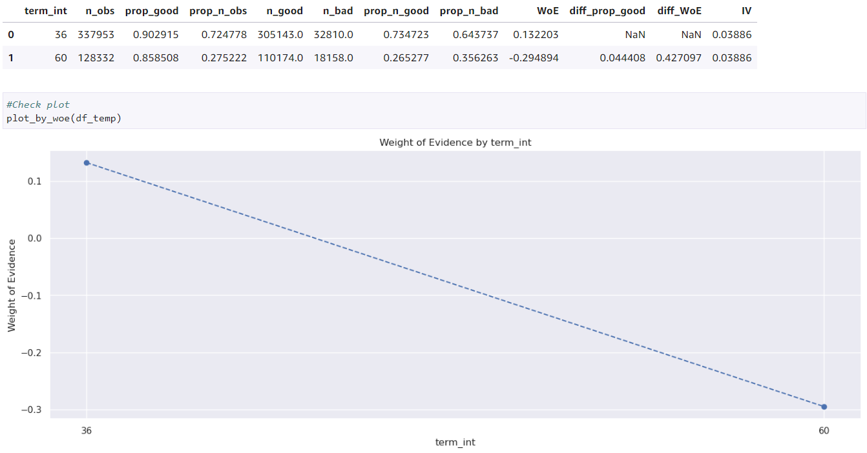
1. grade

Slide 15
Creating dummy variables for continuous features (advanced)
Strategy:
Use Fine classing to create categories based on values
Use coarse classing to combine some of the categories created using fine classing if required
1. mths_since_issue_d​
2. int_rate​
3. mths_since_earliest_cr_line​
4. delinq_2yrs​
5. inq_last_6mths​
6. open_acc​​
7. pub_rec​​
8. total_acc​​
9. acc_now_delinq​​
10. total_rev_hi_lim

Slide 16
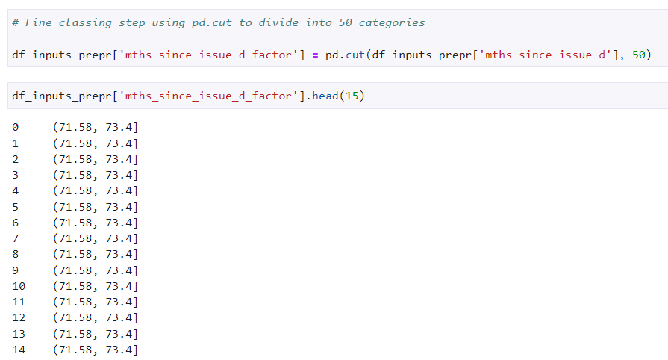
1. mths_since_issue_d

Slide 17
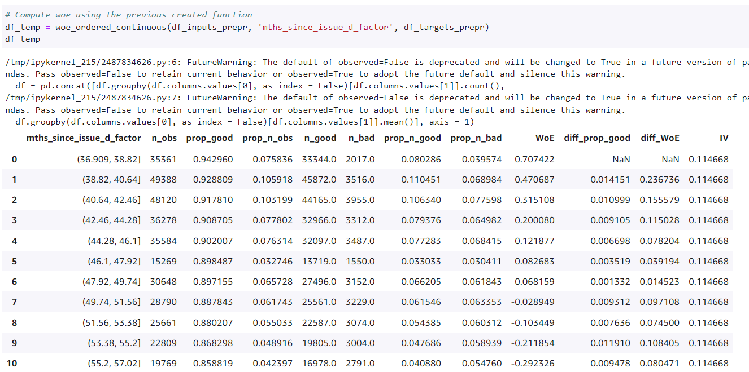
1. mths_since_issue_d

Slide 18
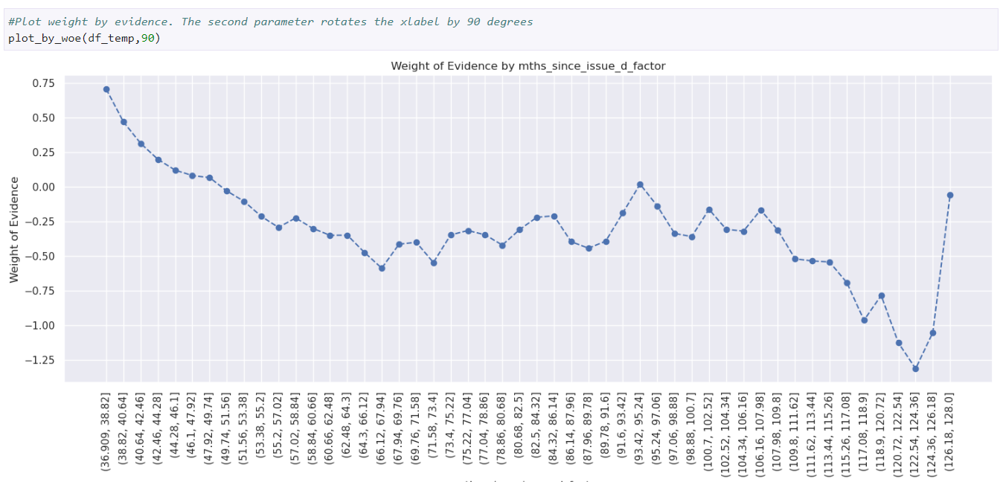
1. mths_since_issue_d

Slide 19
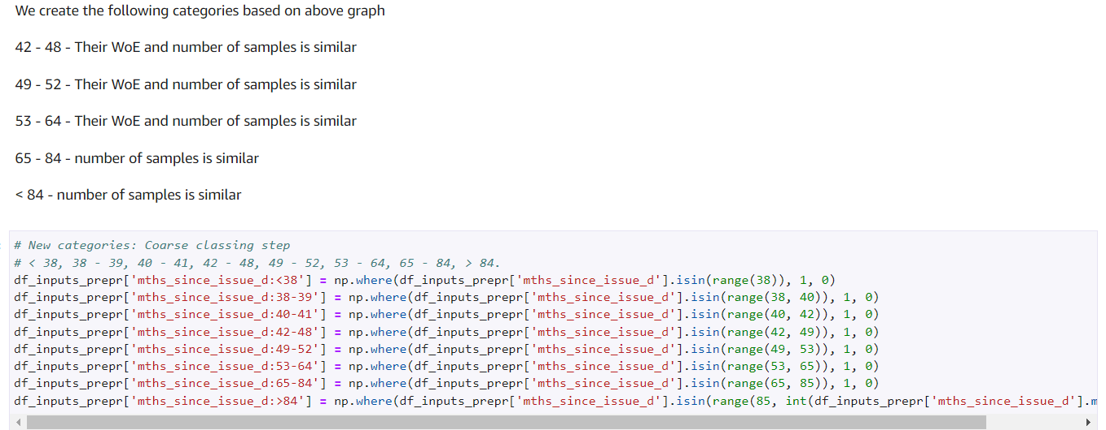
1. mths_since_issue_d

Slide 20
Creating dummy variables for continuous features (special case)
1. annual_inc
2. mths_since_last_delinq
3. dti
4. mths_since_last_record

Slide 21
Train - Test Split
# 80-20 split into train-test sets
loan_data_inputs_train, loan_data_inputs_test, loan_data_targets_train, loan_data_targets_test = train_test_split(df_inputs_prepr,df_targets_prepr, test_size = 0.2, random_state = 42)

Slide 22
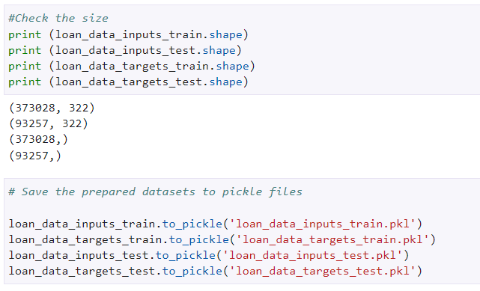
Saving the data

Slide 23
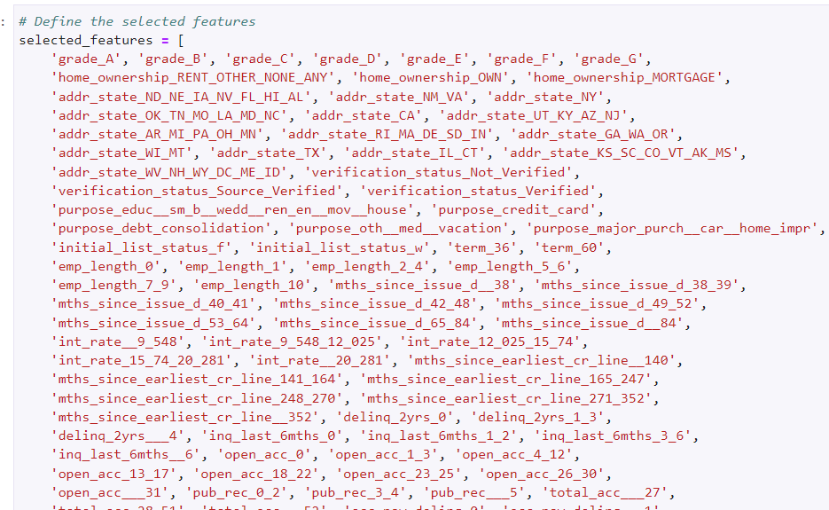
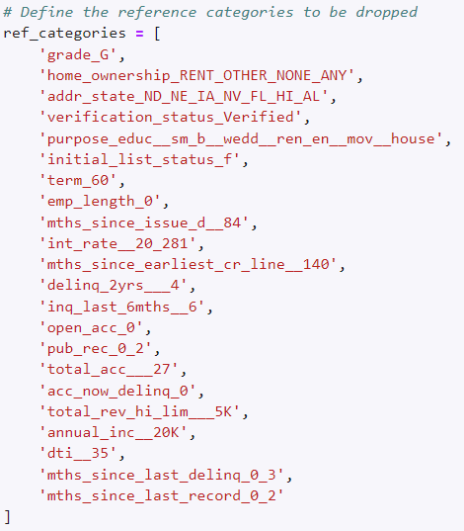
PD Model Fitting Using XGBoost Classifier

Slide 24
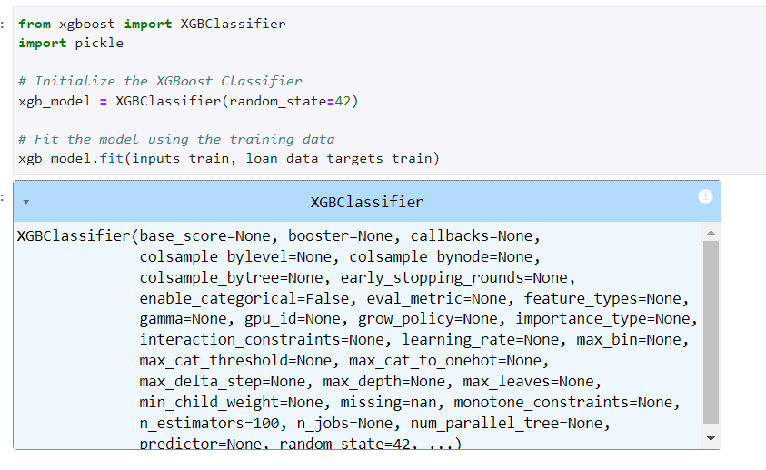
PD Model Fitting Using XGBoost Classifier

Slide 25
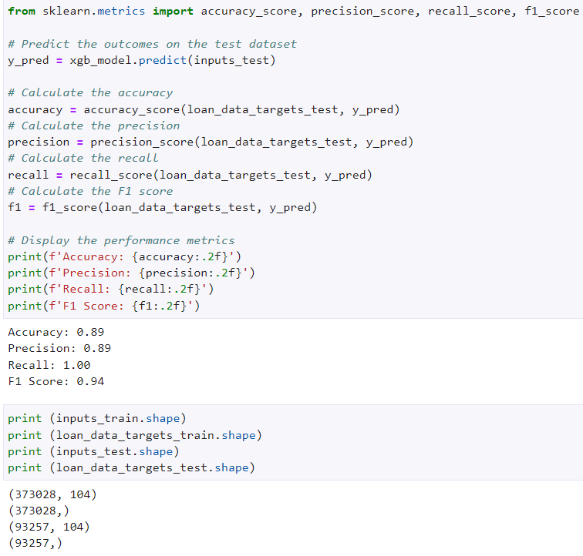
PD Model Fitting Using XGBoost Classifier

Slide 26
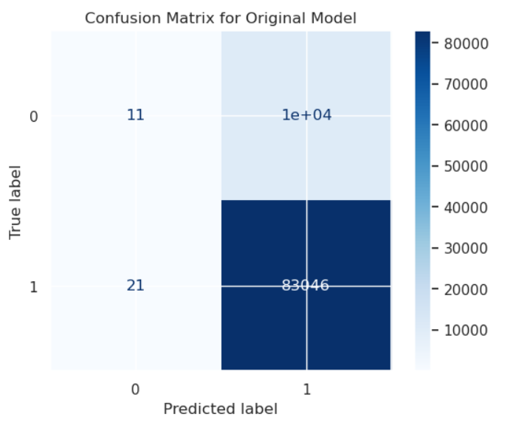
PD Model Fitting Using XGBoost Classifier

Slide 27
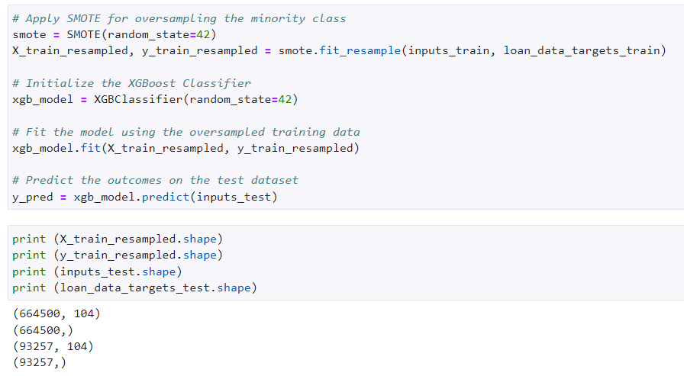
XGBoost Classifier with SMOTE

Slide 28
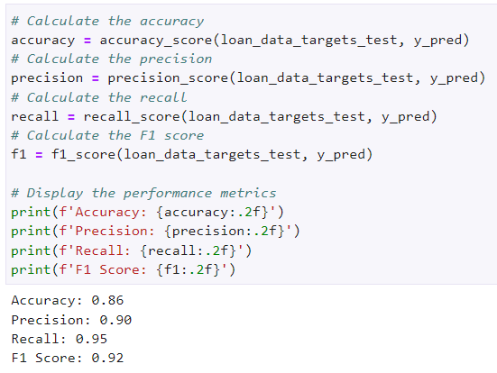
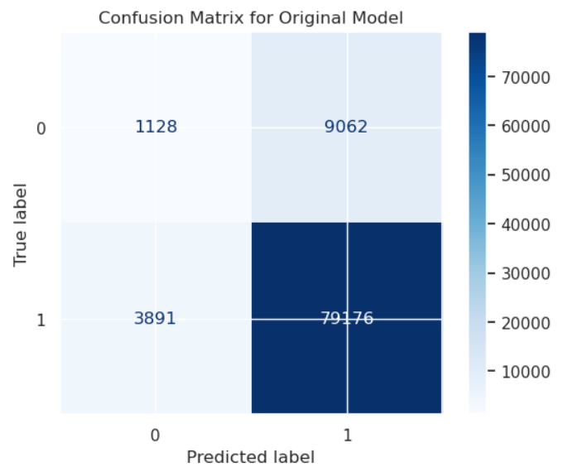
XGBoost Classifier with SMOTE

Slide 29
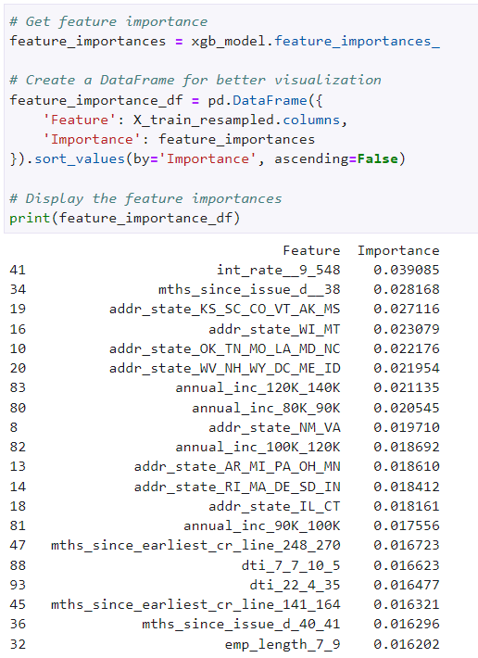
Get feature importance

Slide 30
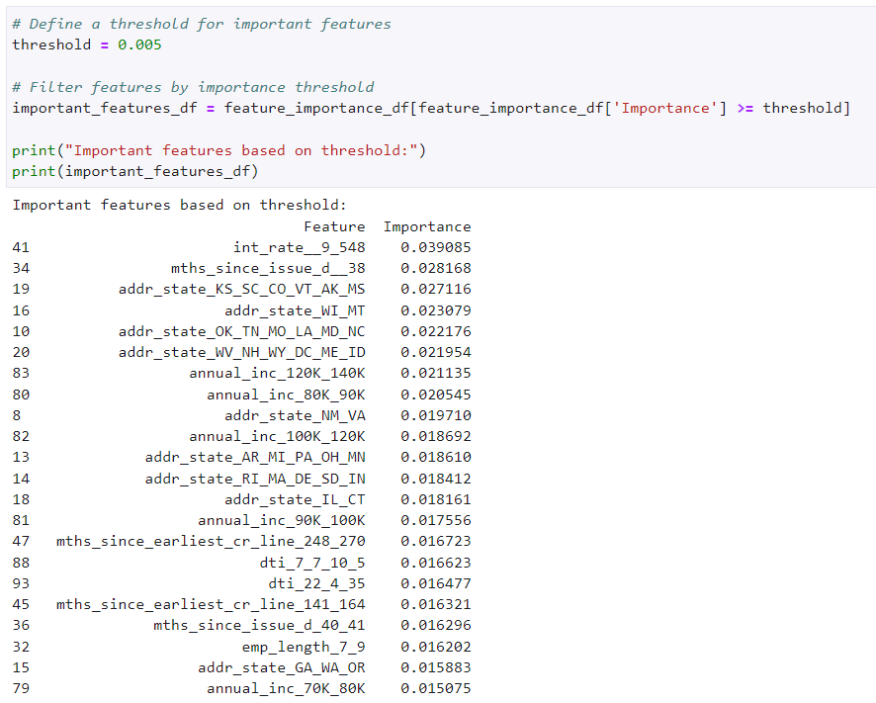
Use 0.005 threshold

Slide 31

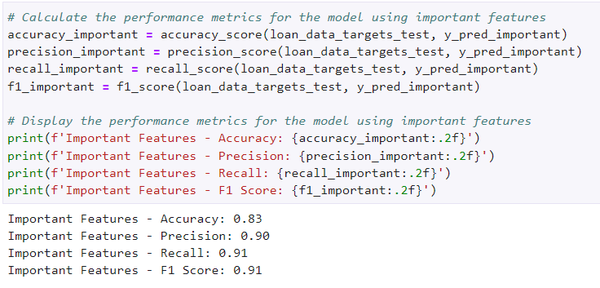
Use the important features in XGboost model

Slide 32
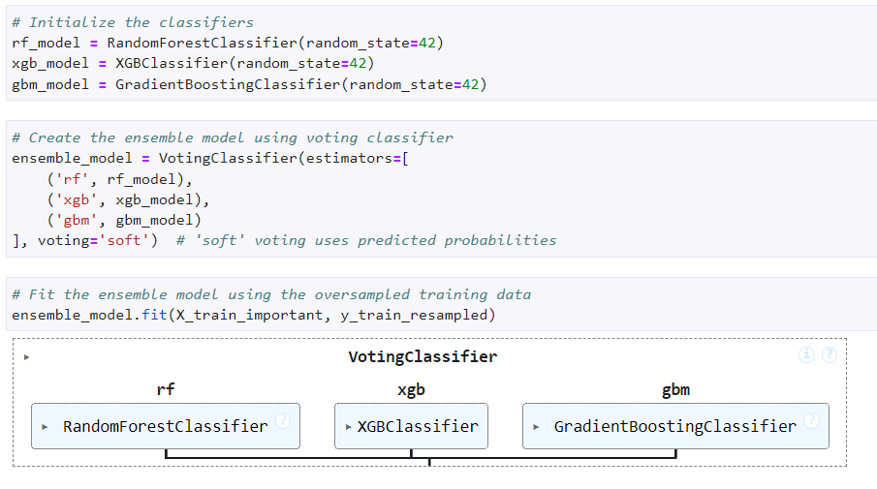
Ensemble Model (XGboost, RandomForest, GradientBoost)

Slide 33
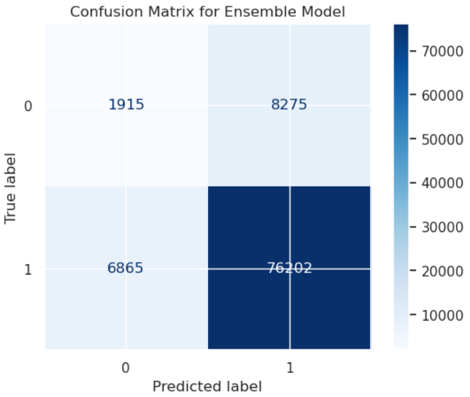
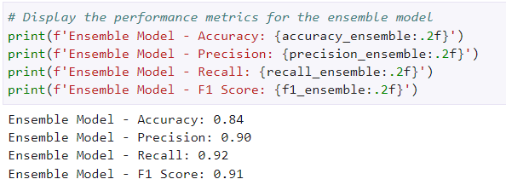
Ensemble Model (XGboost, RandomForest, GradientBoost)

Slide 34
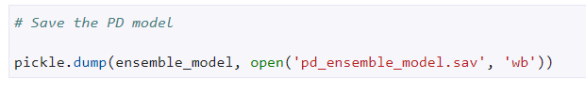
Save the trained ensemble model

Slide 35
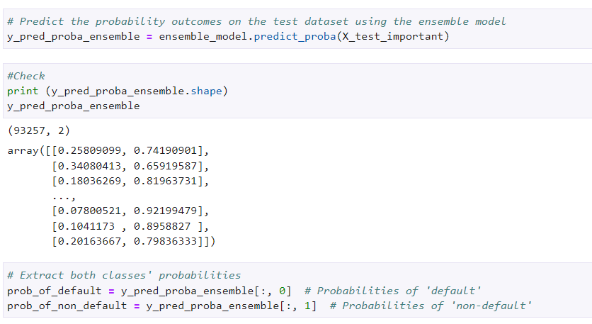
PD Model Validation (Test)

Slide 36
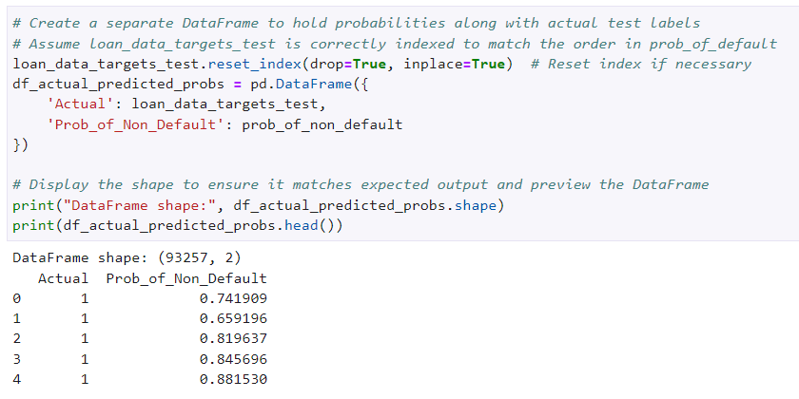
PD Model Validation (Test)

Slide 37
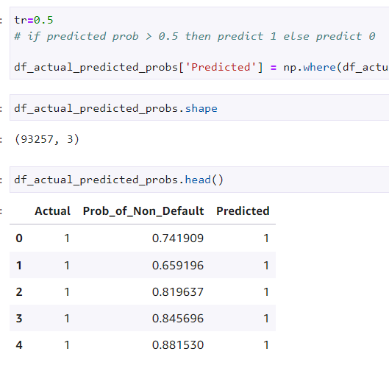
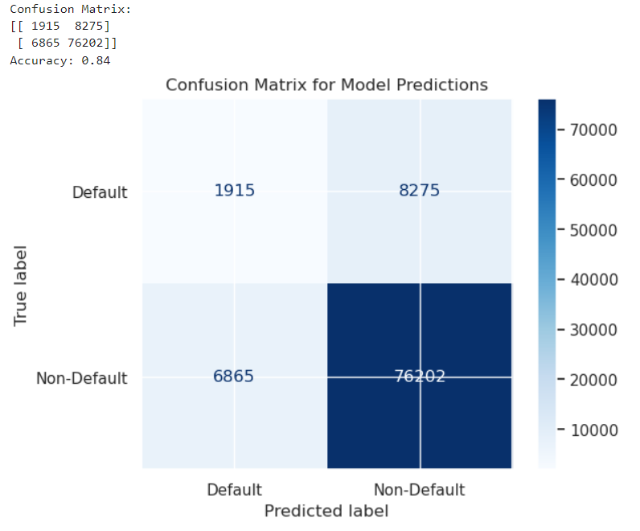
tr = 0.5

Slide 38
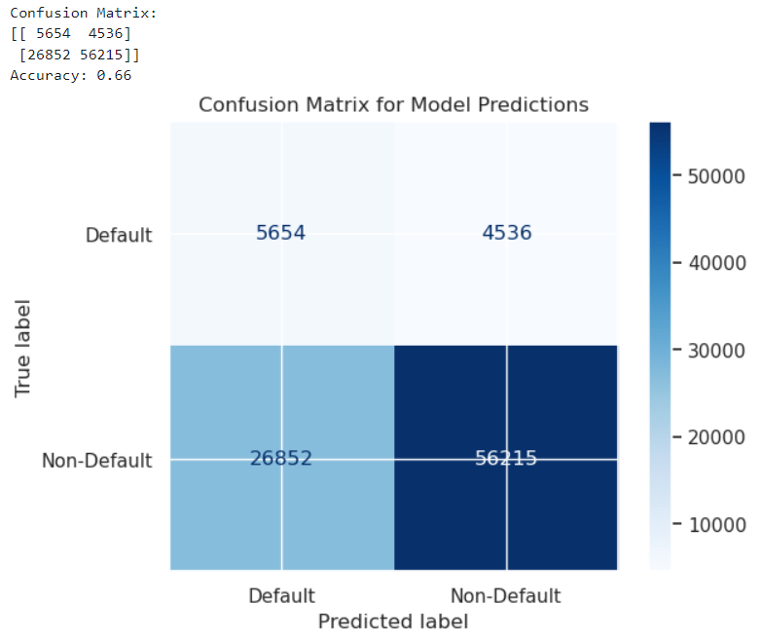
tr = 0.7

Slide 39
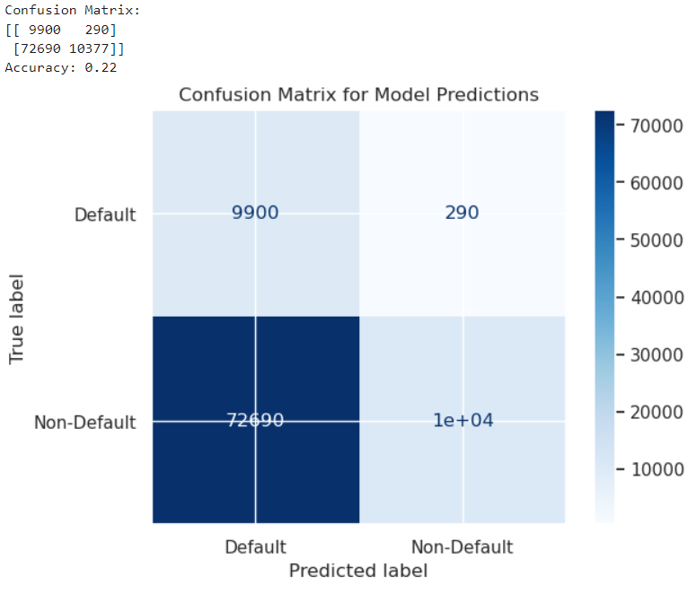
tr = 0.9

Slide 40
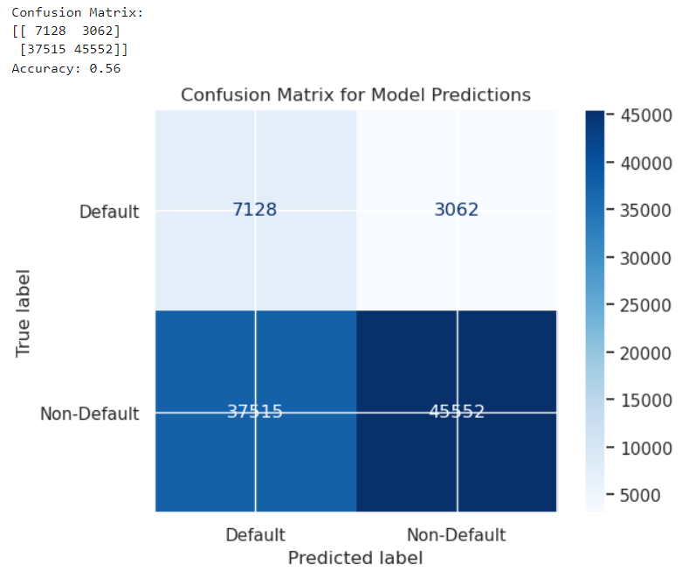
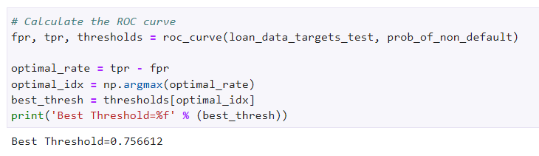
Best tr = 0.756612

Slide 41
LGD Model

Slide 42
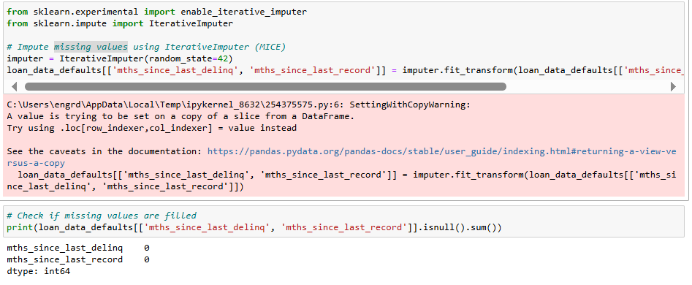
MICE imputer for missing values

Slide 43
Dependent variable for LGD model (recovery_rate)
LGD stands for loss given default
It is the % of the total exposure (total loan) that cannot be recovered once a default has occured
In practice, % of total loan (total exposure) that can be recovered is computed. This is called recovery rate
recovery_rate = recoveries / total_funded_amt
Therefore LGD = 1 - recovery_rate

Slide 44
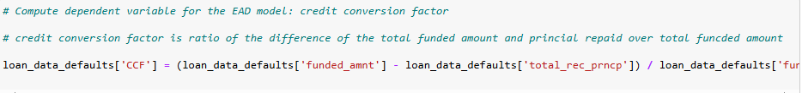
Dependent variable for EAD model (credit_conversion_factor)
EAD stands for exposure at default
It is the maximum value a lender will loose when a default occurs.
For home loan for example, a borrower would have generally paid back some of the principal before the default occurs.
The % that is unpaid is often called "credit conversion factor".

Slide 45
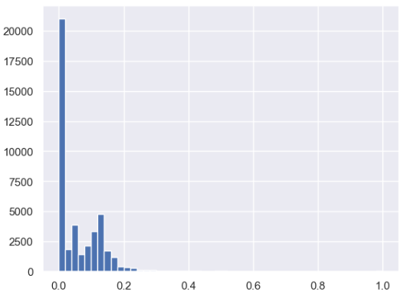
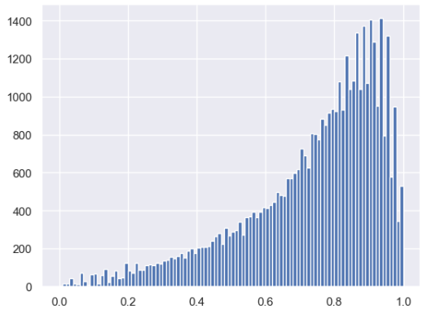
Exploration of dependent variables for LGD and EAD models

Slide 46
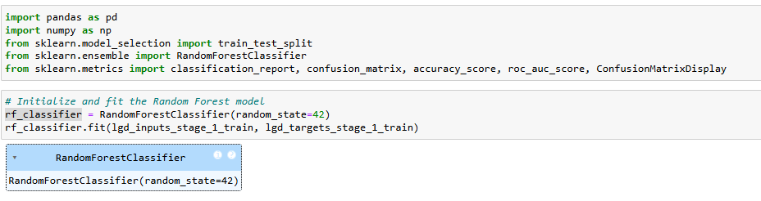
LGD Model stage 1 - Random Forest to predict recovery_rate 0 or 1

Slide 47
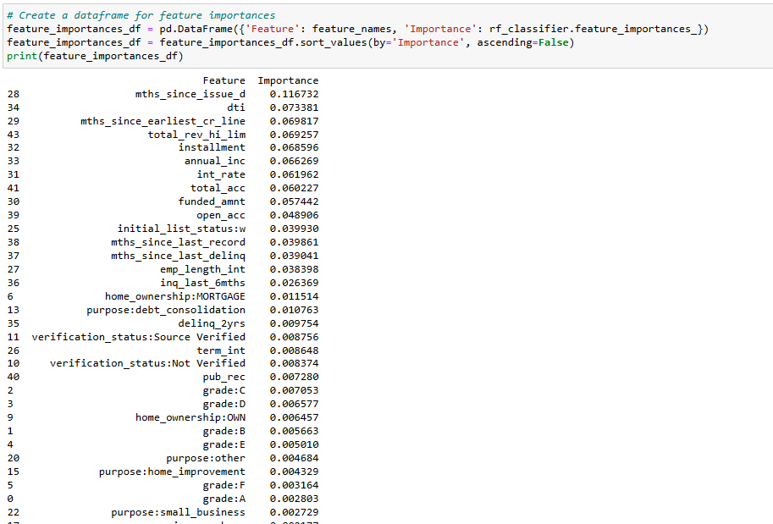
LGD Model stage 1 – Feature Importance

Slide 48
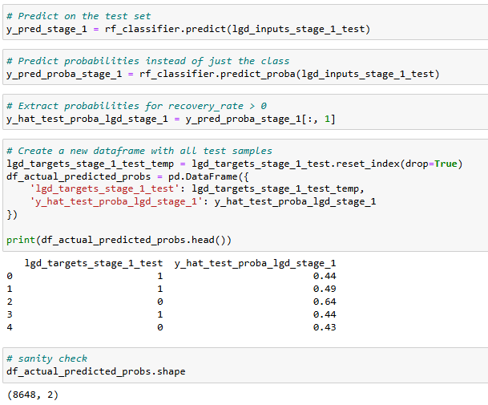
LGD Model stage 1 – Model Testing

Slide 49
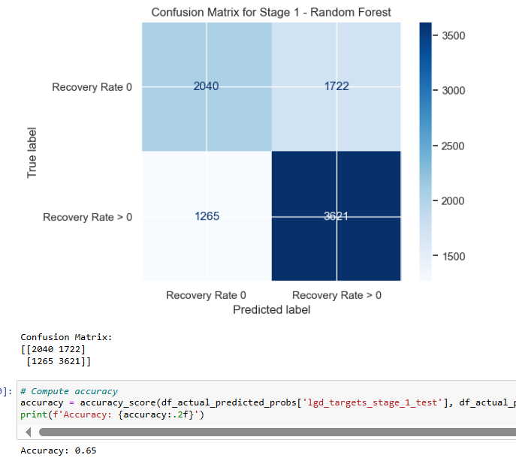
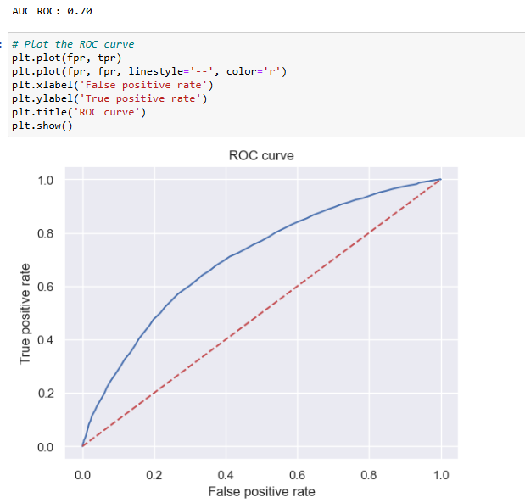
LGD Model Stage 1 - Random Forest: tr = 0.5

Slide 50
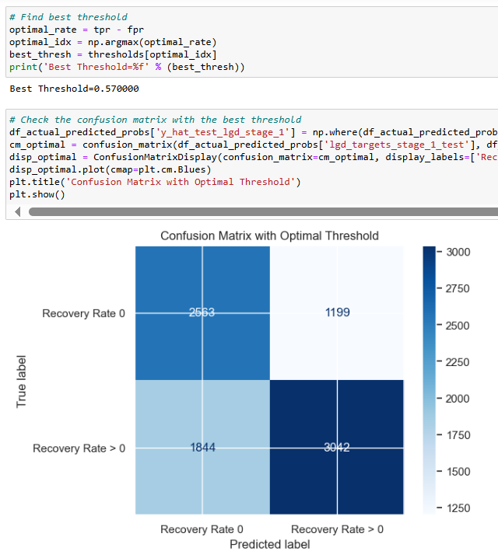
LGD Model Stage 1 - Random Forest: Best tr

Slide 51
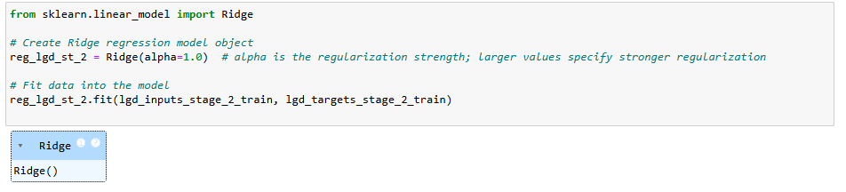
Stage 2 model - Ridge Regression

Slide 52
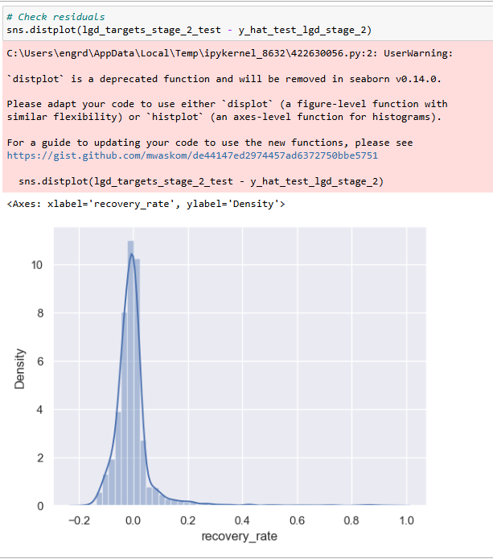
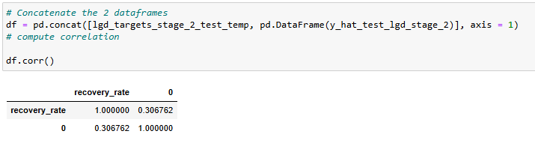
Stage 2 model - Ridge Regression

Slide 53
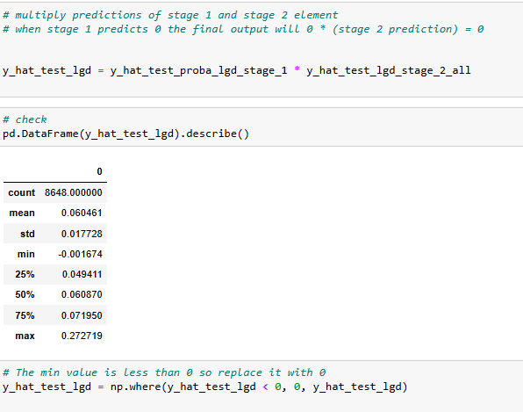
Combining stage 1 and stage 2 to create final LGD model

Slide 54
EAD Model

Slide 55
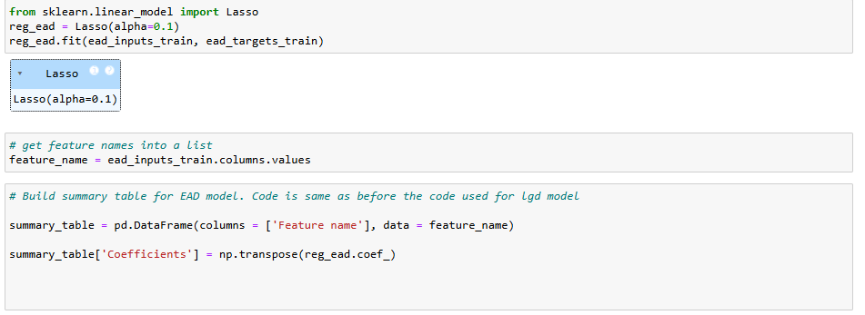
Lasso Regression for EAD Model

Slide 56

Lasso Regression for EAD Model

Slide 57


Lasso Regression for EAD Model

Slide 58
Expected Loss

Slide 59

Load Saved Models

Slide 60

Compute the Probability of Default

Slide 61
Compute the Probability of Default

Slide 62

Compute LGD

Slide 63

Compute LGD

Slide 64

Compute EAD

Slide 65

Expected Loss. EL = PD * LGD * EAD = 516143665

Slide 66

EL / Funded Amount Ratio = 0.077452

